Slide 1




Riciclo CO₂ e processi chimici sostenibili:
l’esperienza del ricercatore.
Luca Lietti
Incontro ITI Omar, Novara 15.12.21

Slide 2

OUTLINE
The energy scenario and CO₂ emissions
Technologies for CO₂ capture and utilization
Research trends in the CO₂ utilization
Main players in the field
CONCLUSIONS

Slide 3
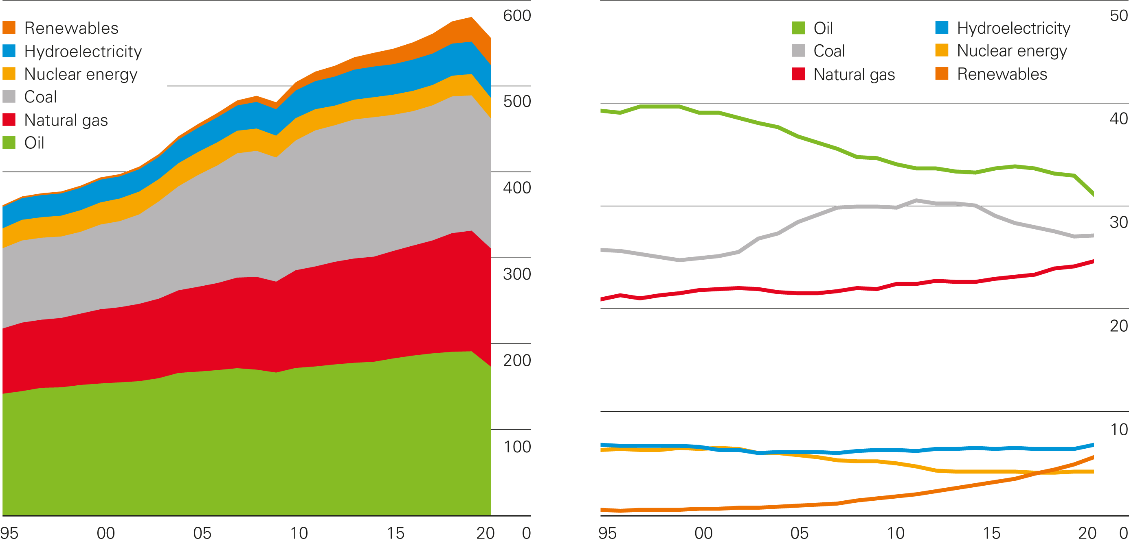
The Energy Scenario
World consumption
Exajoules
Shares of global primary energy
Percentage
Statistical Review of World Energy 2021
© BP p.l.c. 2021
Most of the energy demand is currently satisfied with fossil fuels

Slide 4
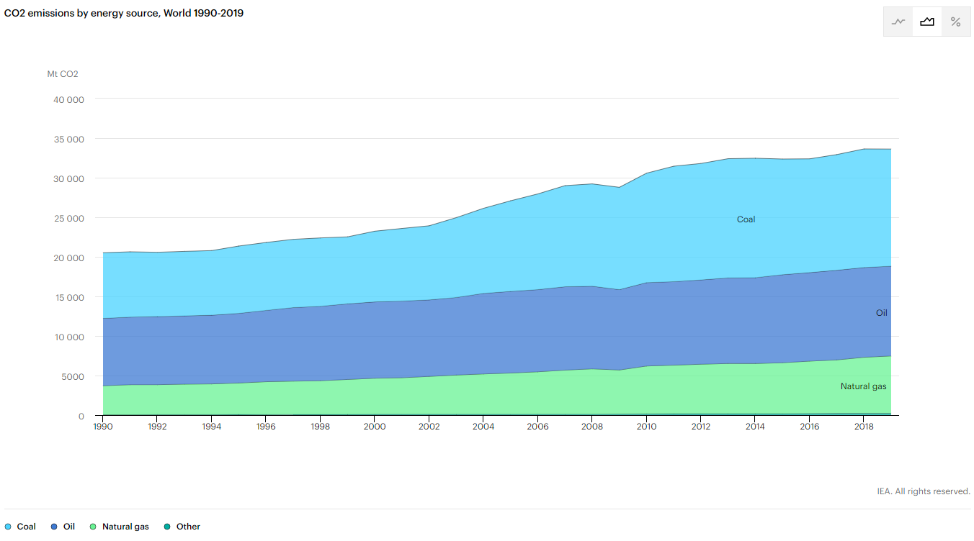
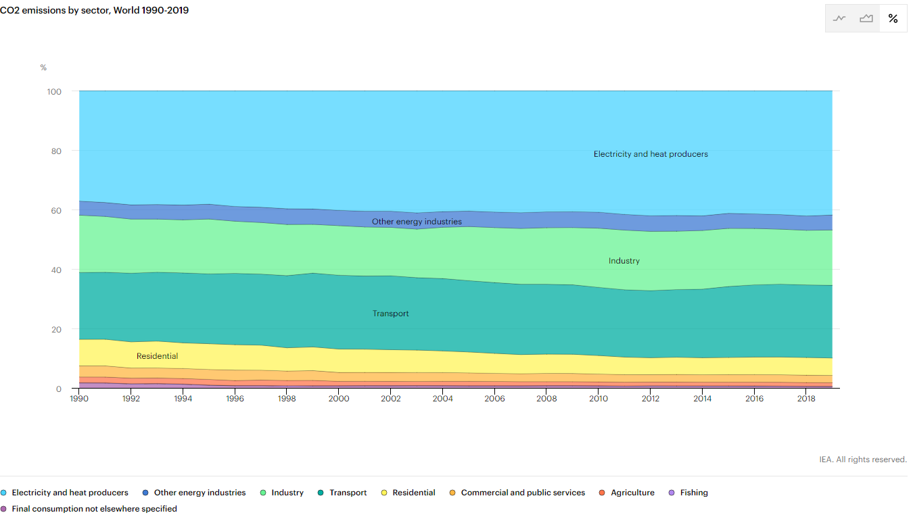
The Energy Scenario
BP Energy Outlook, 2020 Edition
IEA, © 2021
The combustion of fossil fuels emits large amounts of CO₂ in the atmosphere

Slide 5

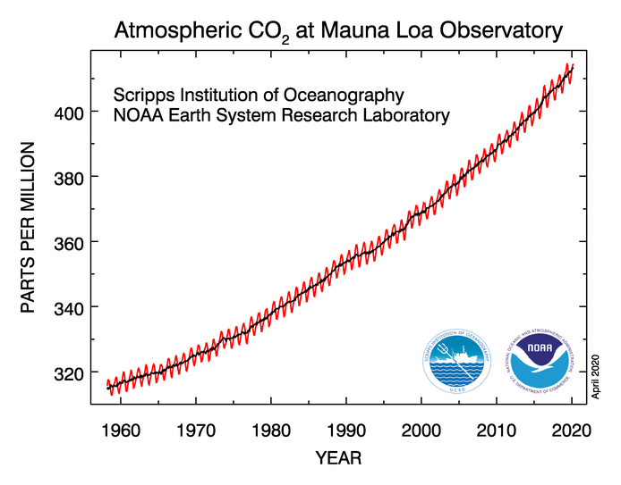


Consequences of CO2 emissions
  Paul Sudders, National Geographic
  Nature Climate Change 10 (3) cover, 2020
  earthobservatory.nasa.gov/images/hurricane-sandy
CO₂ concentration in the atmosphere exceeded 415 ppm in April 2020
anthropic CO₂ is blamed to be the primary responsible of climate change

Slide 6
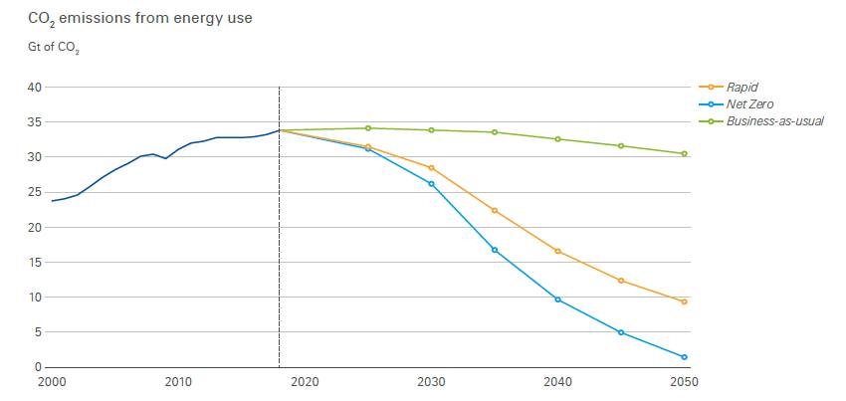
CO2 emissions: what’s next ?
To reduce CO₂ emissions we need to cut the consumption of fossil fuels
We are in the “energy transition” age towards zero- or low-carbon energy sources and vectors

Slide 7
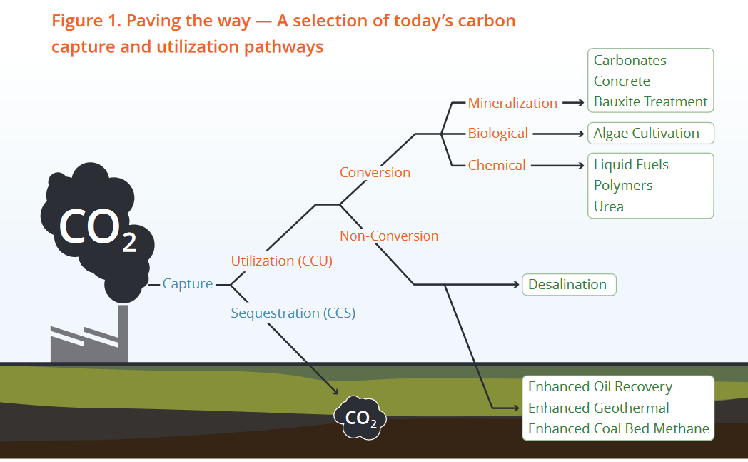
Reduction of CO2 emissions: CCS and CCU
70% of CO₂ is emitted at point source (localized emitters) and can be easily captured
CCS is a treatment of the symptoms but does not eliminate the sources of CO₂
CCU uses CO₂ as building block, allowing a sustainable carbon cycle strategy

Slide 8
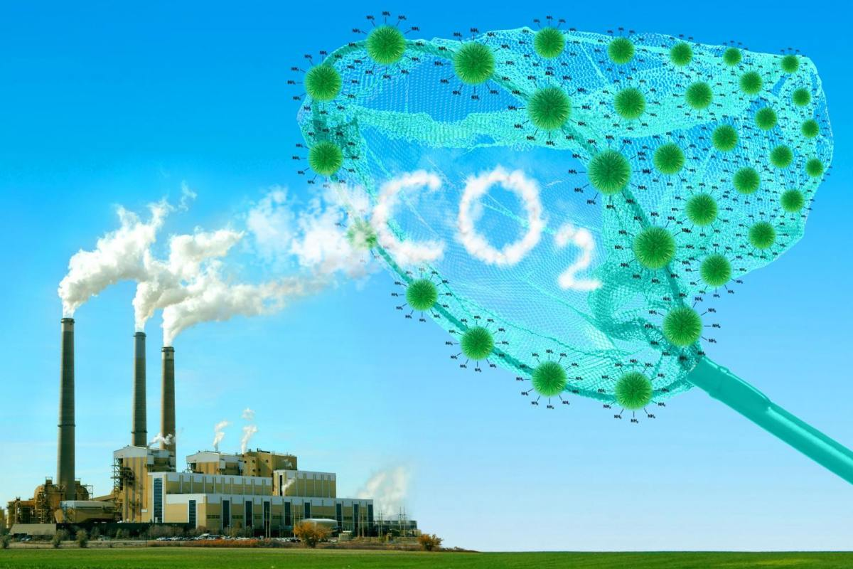
CO2 capture
First step in the CCS and CCU technologies
Technologies are available for the removal of CO₂ from flue gases
Direct Air Capture (DAC) is inherently more expensive and requires technological breakthrough to become economically feasible

Slide 9
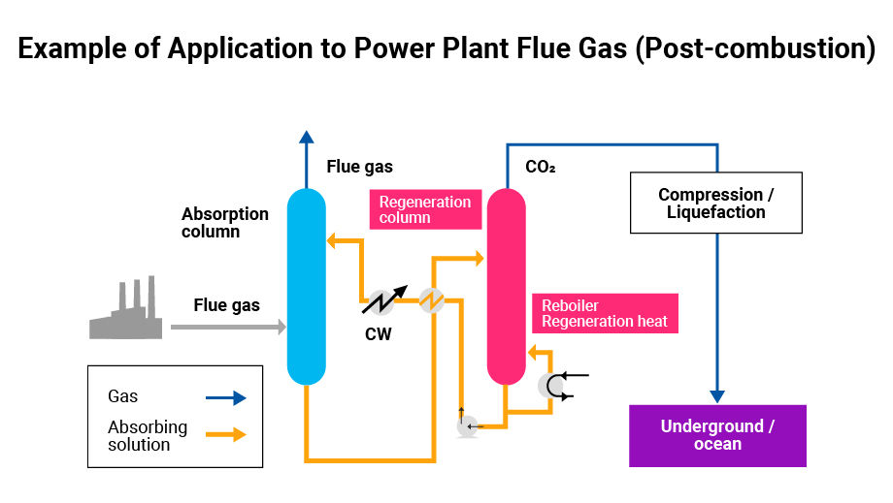
CO2 capture
Direct Air Capture (DAC) is carried out upon adsorption on solid materials

Slide 10
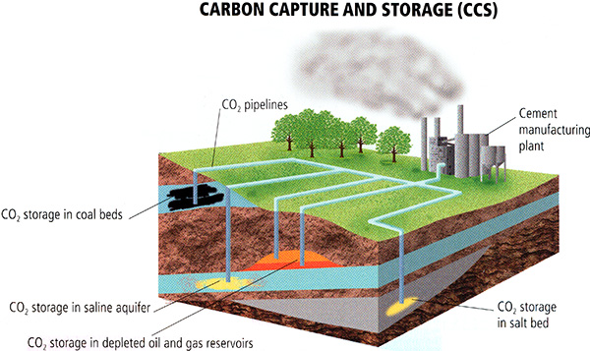
Reduction of CO2 emissions: CCS

Slide 11
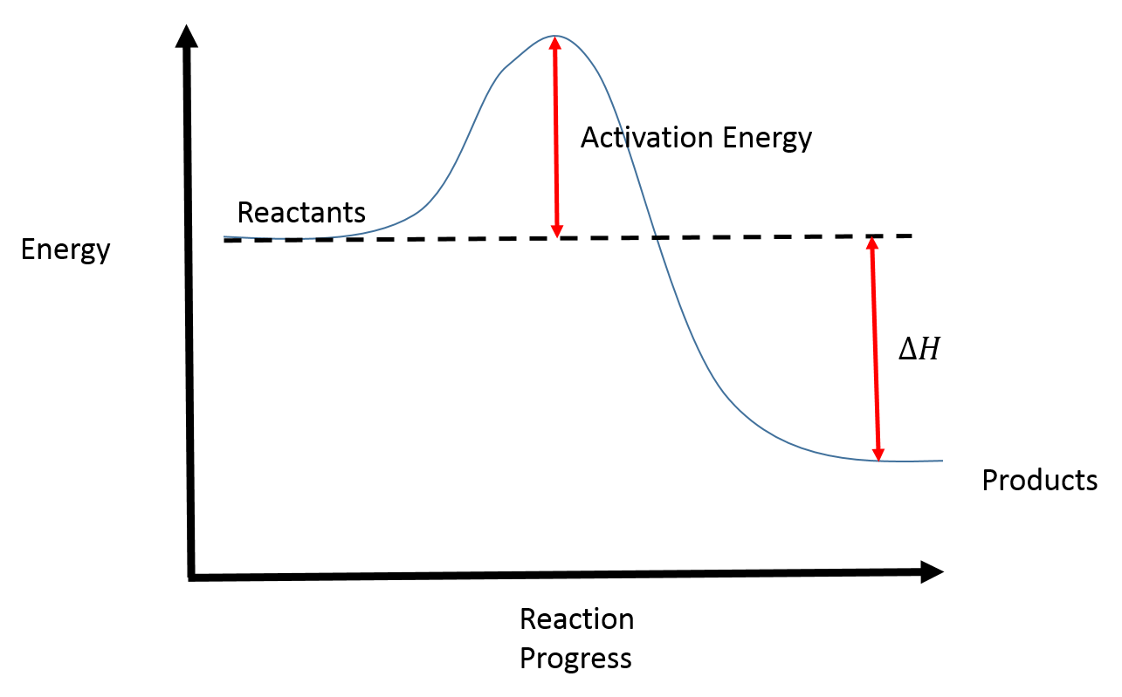
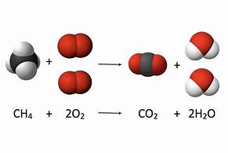
Reduction of CO2 emissions: CCU
Chemical conversion
CO₂ is the final product of the combustion of a fossil fuel (transformation of chemical energy into thermal energy)
CO₂ is a very stable molecule and is poorly reactive
It is possible to convert CO₂ back to fuels, hydrocarbons and chemicals: we need energy or highly reactive molecules (e.g. H₂)!
+ heat

Slide 12
Chemical CO2 utilization
Fuels
chemicals
Catalytic reactor
CO₂
H₂
CO₂ hydrogenation allows the production of synthetic fuels (methane, gasoline, diesel fuel) or chemicals (methanol, olefins) with net reduced- or zero-CO₂ footprint!
Low-cost renewable H₂ (green H₂) is necessary for the sustainability of CCU processes

Slide 13
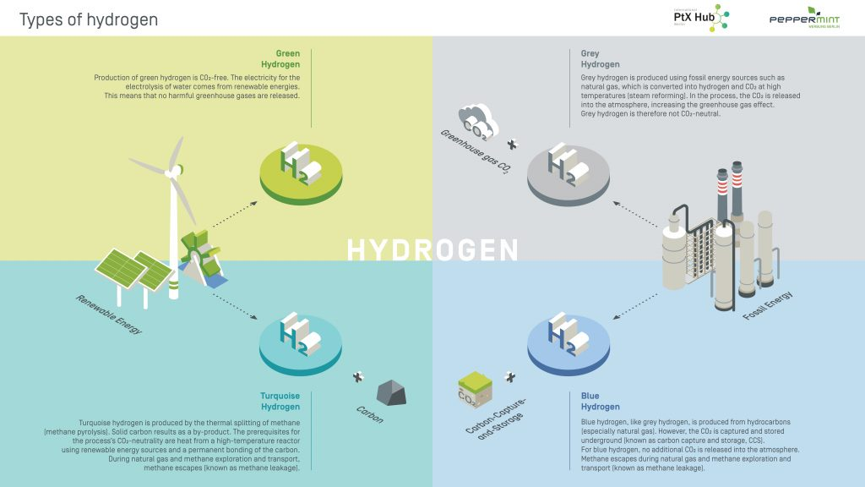
The colors of H2

Slide 14




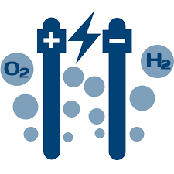






Chemical CO2 utilization
H₂O
Electrolysis
H₂
CO₂
Fuels
chemicals
Catalytic reaction

Slide 15
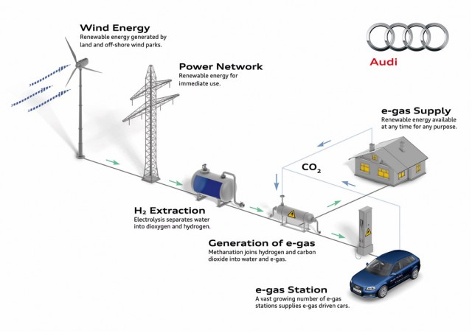
CO2 to gaseous fuels (SNG)
Used also as «storage» of energy (Power-to-gas, power-to-liquids)
$$CO2+4H_{2}↔CH4+2H_{2}O ∆H_{}^{0}\left(298K\right)=−165.1 {kJ}/{mol}$$
Catalytic reaction carried out over Ru- or Ni-based catalysts
LCCP

Slide 16
Chemical CO2 utilization
H₂O
Key-aspects in research
Electrolysis
H₂
CO₂
Fuels
chemicals
Catalytic reaction
Catalytic reaction

Slide 17
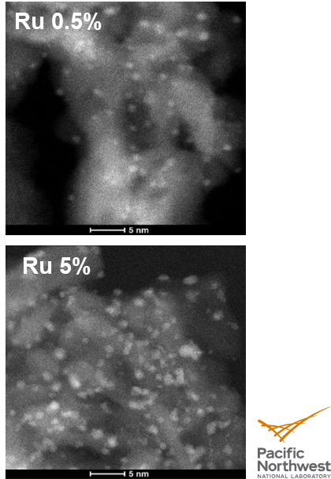
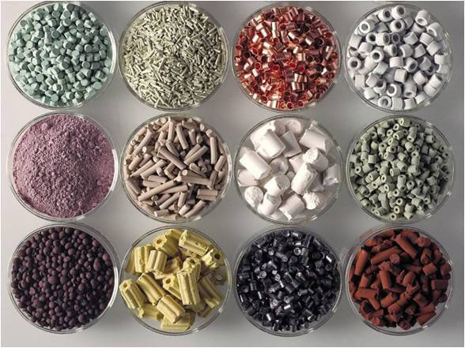
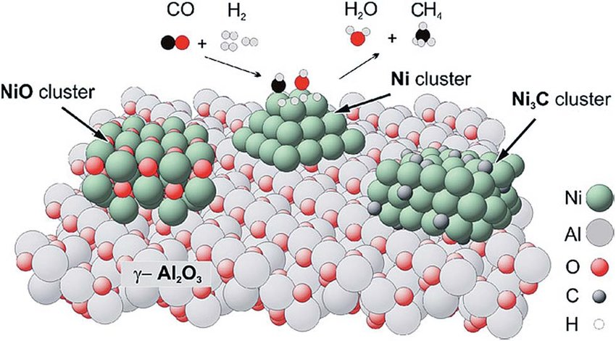
Research trends in CO2 conversion
CO₂ can be transformed (hydrogenated) into fuels (e.g methane, liquid fuels) and chemicals (e.g. methanol, olefins)
To hydrogenate CO₂ we need a catalyst!
In these applications, heterogeneous catalysts are used
  New catalytic materials are required!

Slide 18

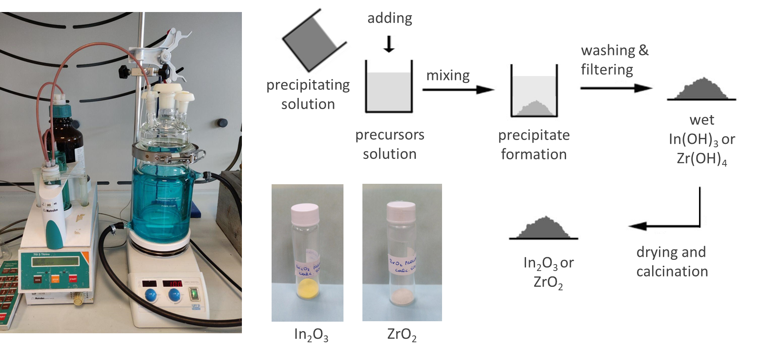
Research trends in CO2 conversion
  New catalyst formulation
LCCP
18

Slide 19

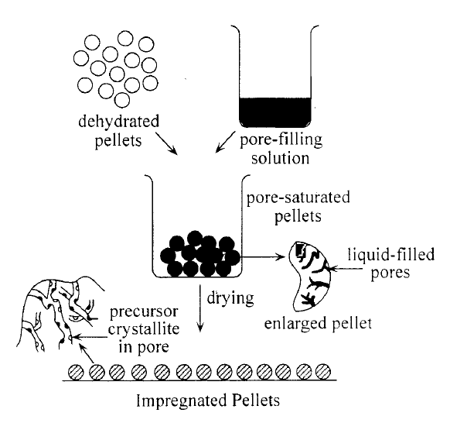
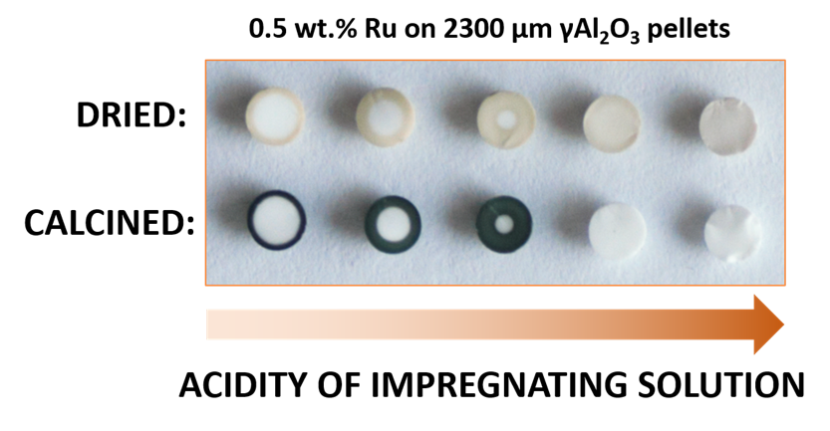

Research trends in CO2 conversion
Catalysts having different shapes and phase loadings can be prepared

Slide 20
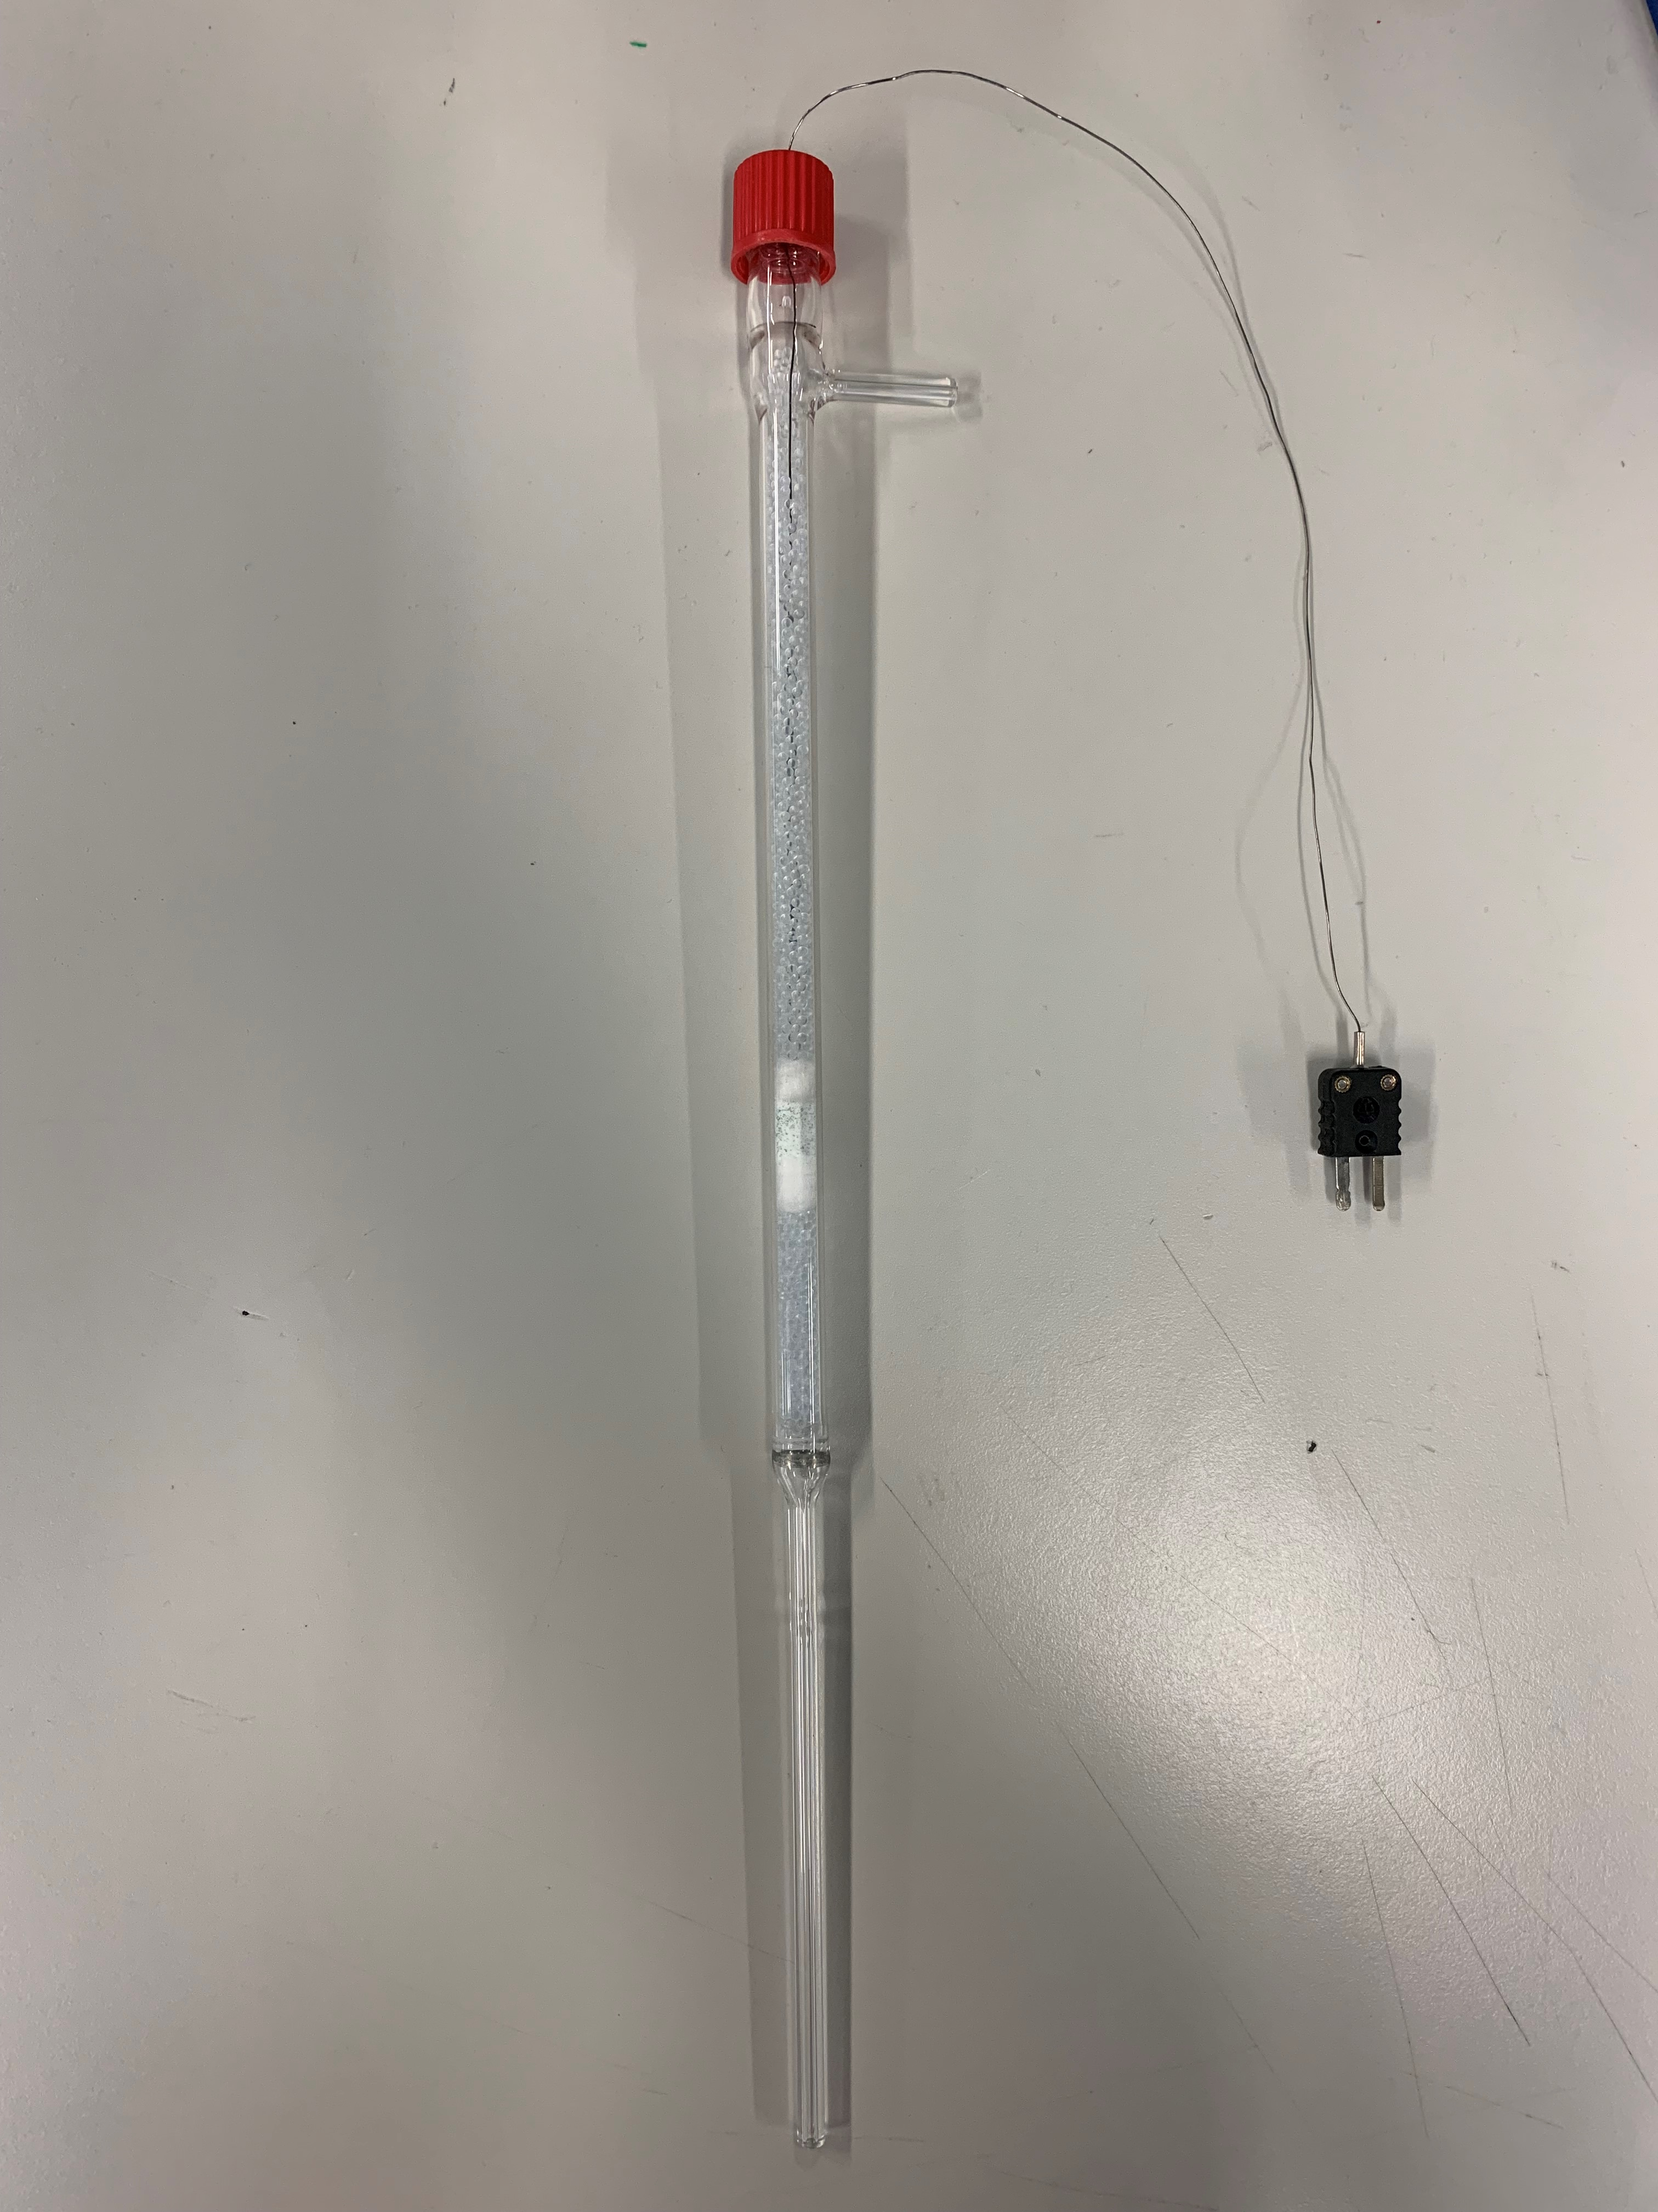
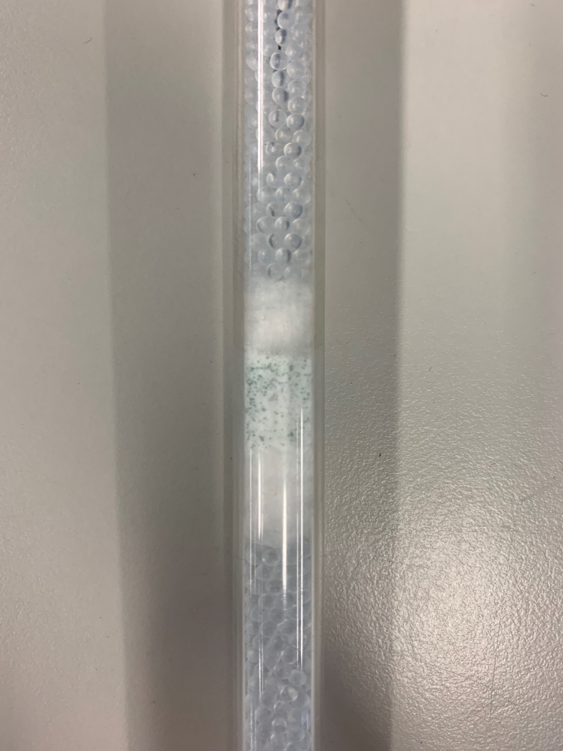
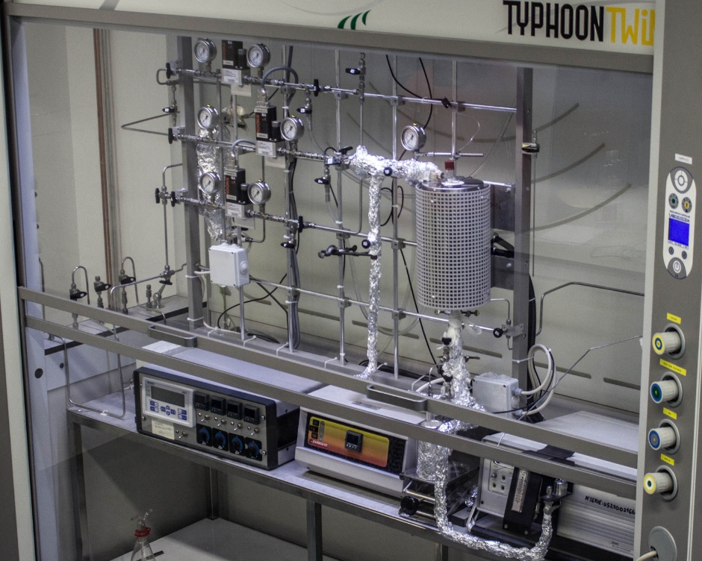
Research trends in CO2 conversion
  Catalyst testing
  The catalyst performances can be evaluated
LCCP
20

Slide 21
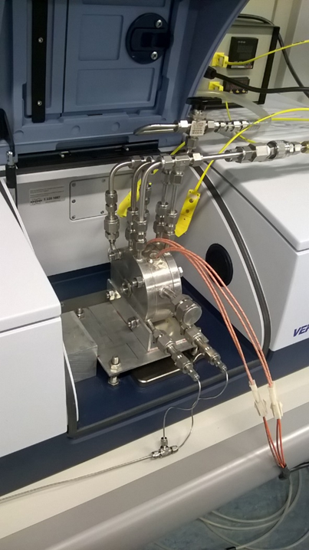
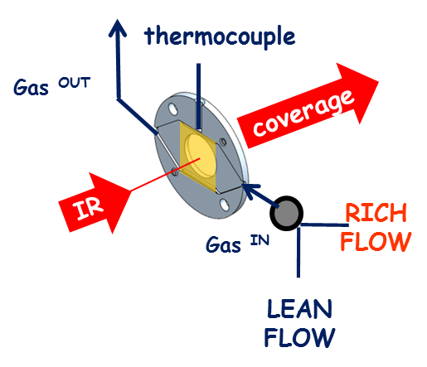
Research trends in CO2 conversion
  Mechanistic studies – spectroscopic reactor
Operando FTIR spectrokinetic reactor
simultaneous analysis of surface and gas-phase species
reaction mechanisms can be derived!
LCCP
21

Slide 22
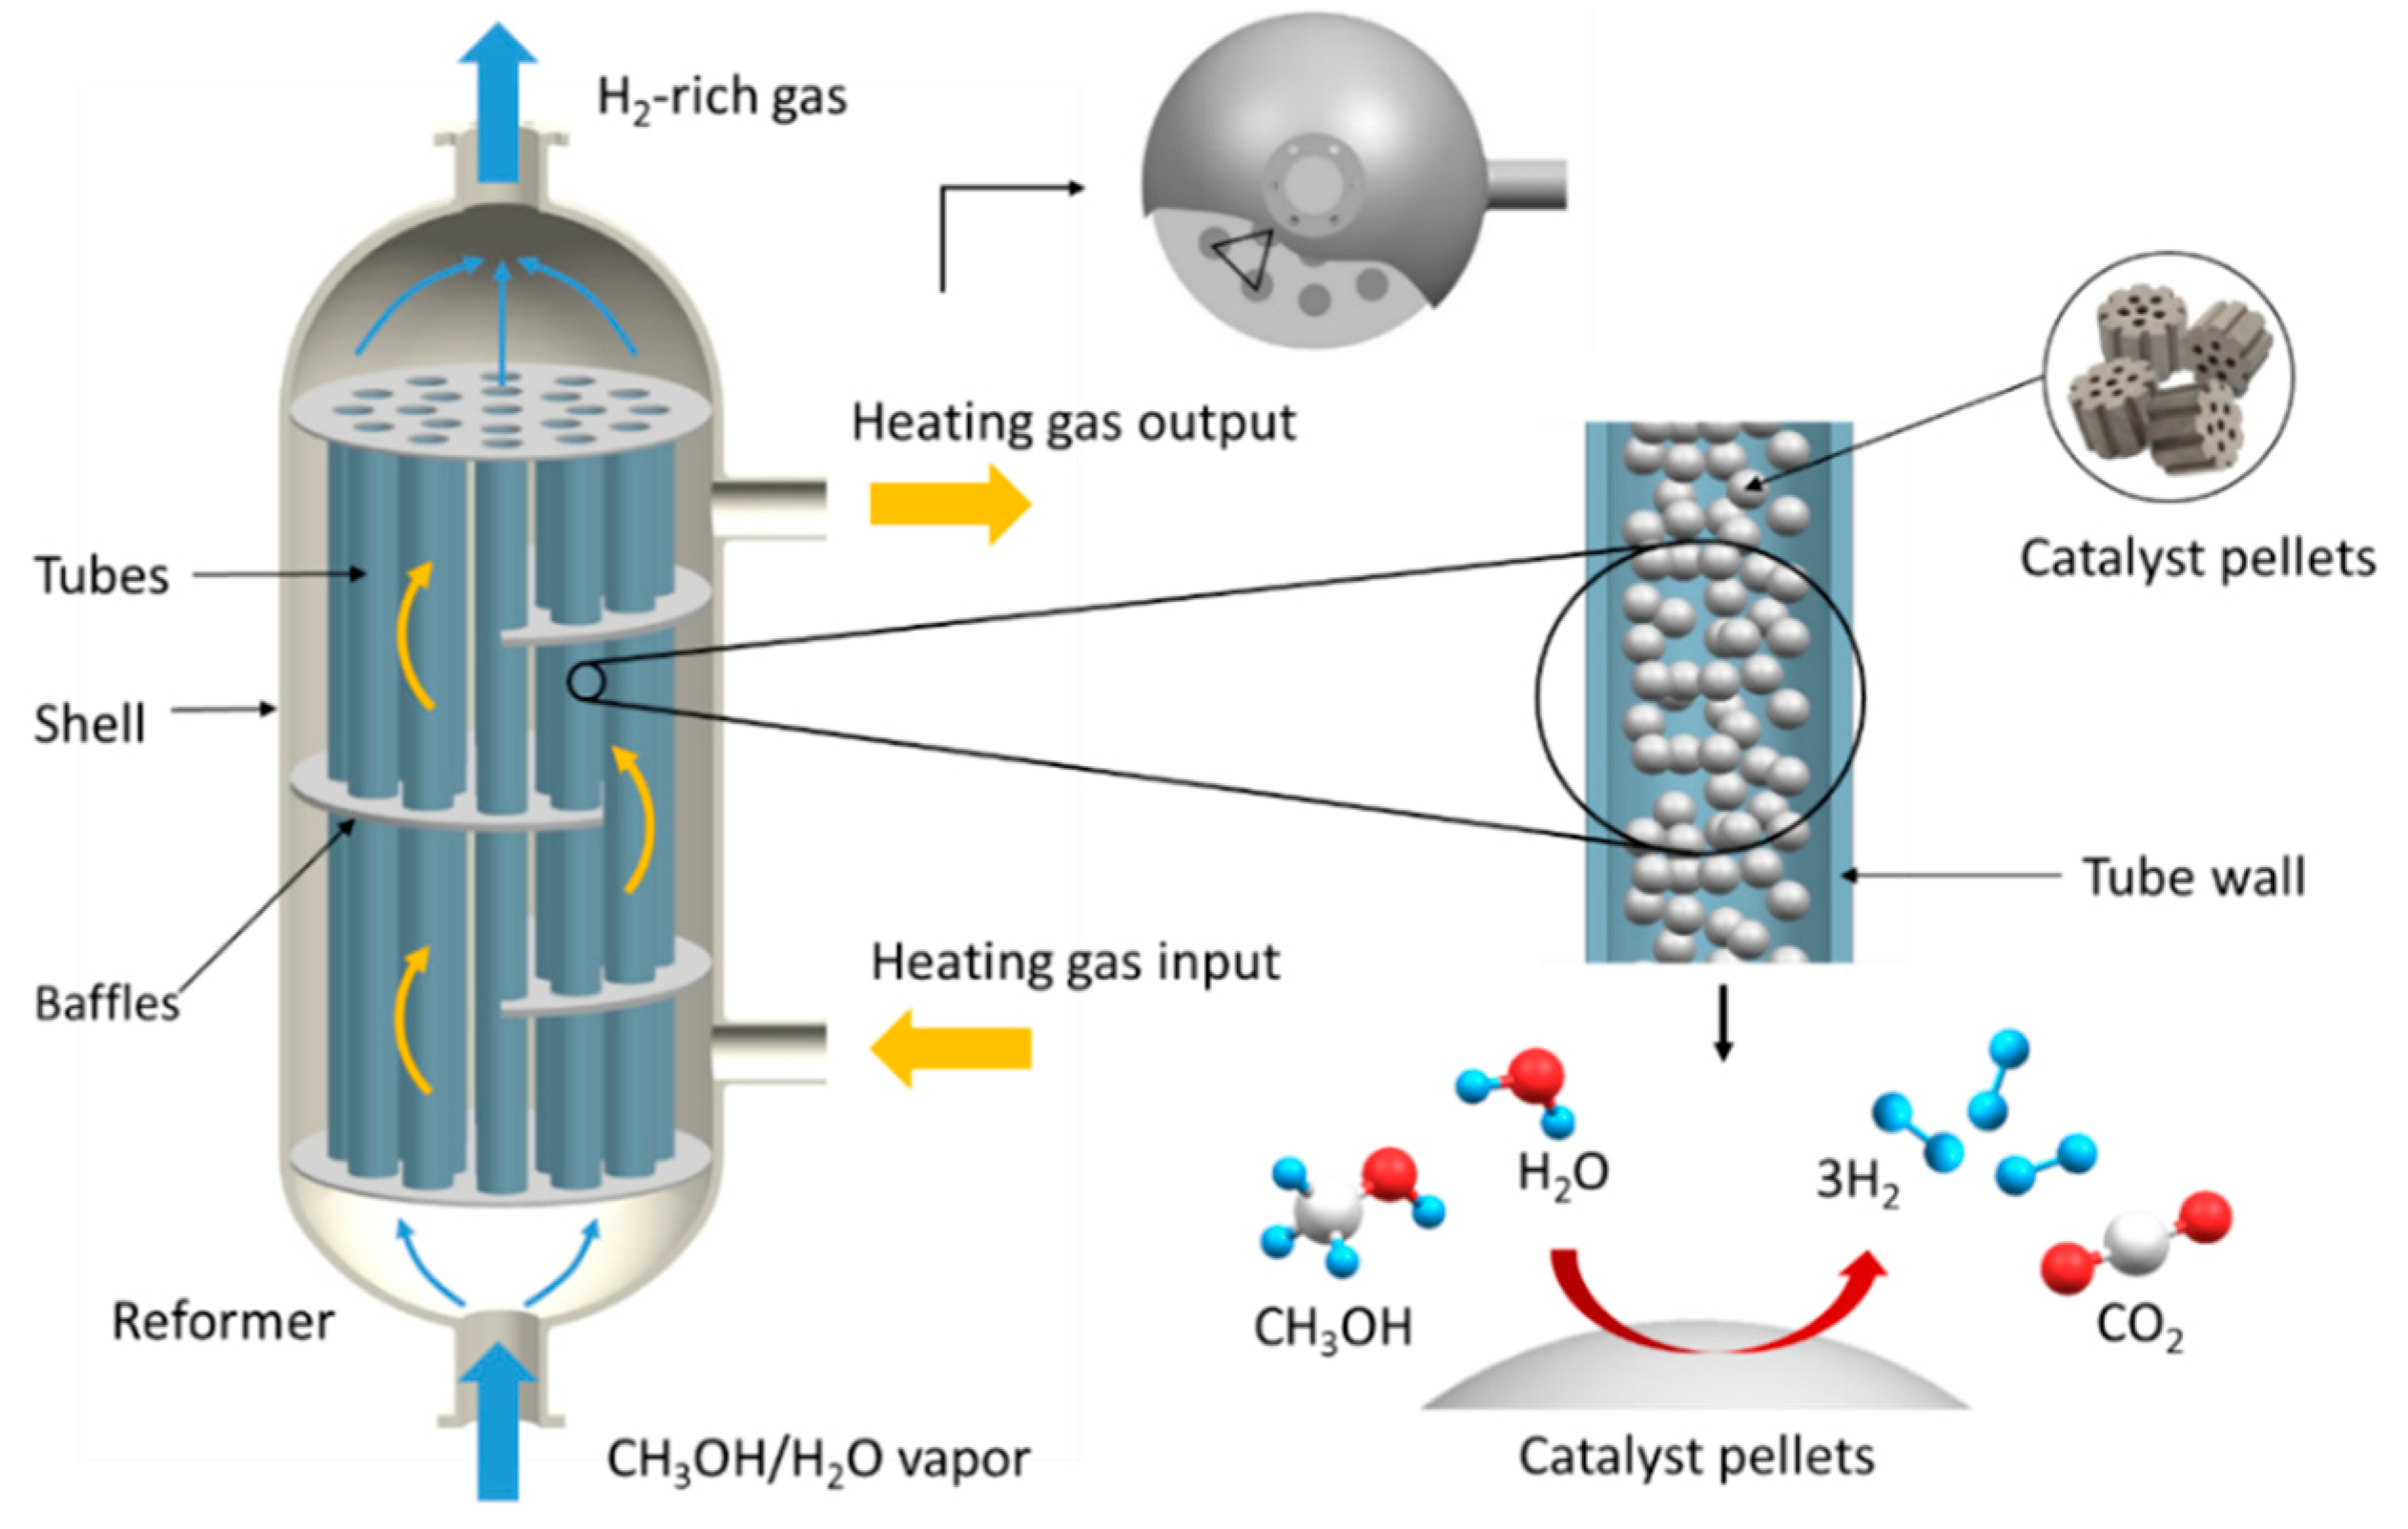
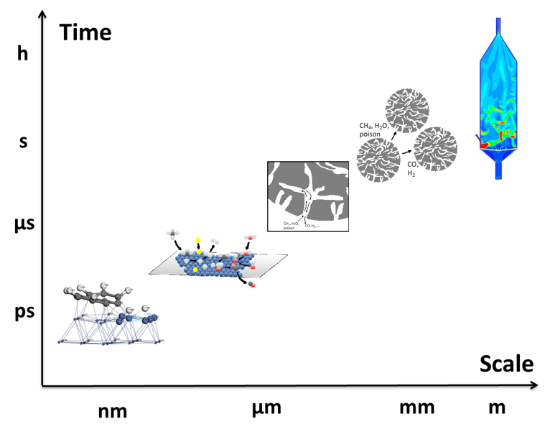
Research trends in CO2 conversion
  Modeling of the catalytic reaction, from the micro- to the macro-scale
  Temperature profiles in the catalyst bed

Slide 23
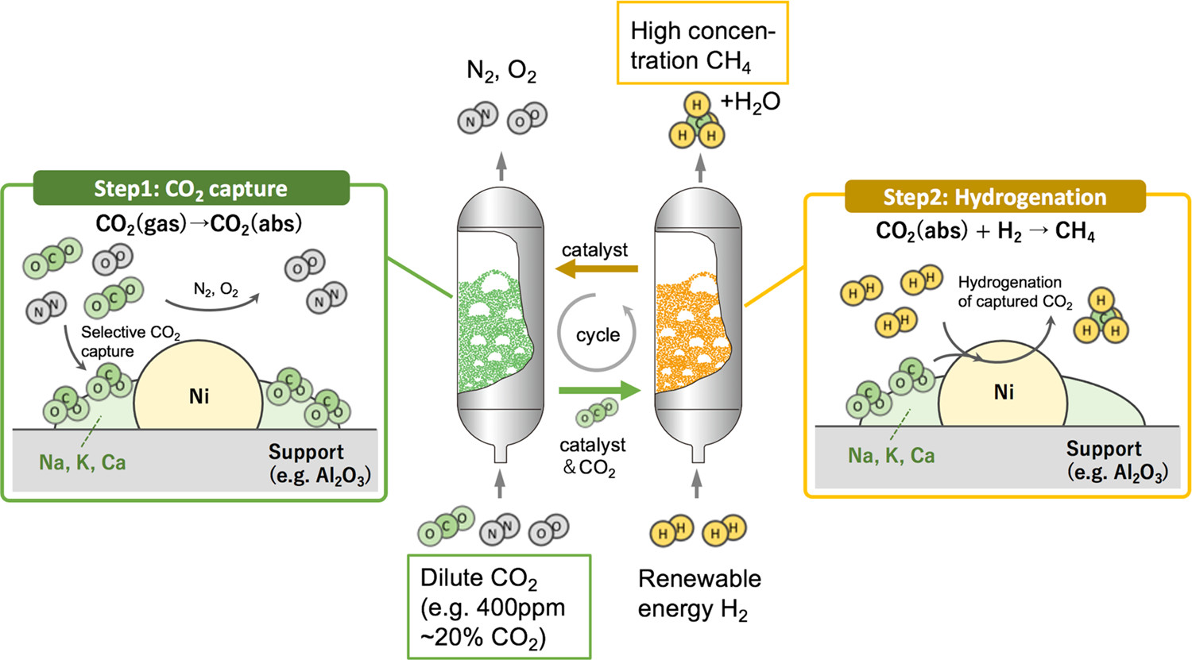


Research trends in CO2 conversion
Cyclic CO2 hydrogenation (methanation)
catalyst
catalyst
adsorbent
adsorbent
support
support
Adapted from: Kosaka et al., ACS Sustainable Chem. Eng. 2021, 9, 9, 3452–3463
  Based on a cyclic scheme involving CO₂ adsorption and hydrogenation (no need of a CO₂ separation unit)
  Utilization of Dual Function Materials (DFMs) comprising a CO₂ adsorbent and a hydrogenation catalyst:
    Ru for the hydrogenating function
    Alkaline or alkaline earth materials as CO₂ adsorbent

Slide 24
Research trends in CO2 conversion
  Major players:
  Public research centres (CNR, ENEA), universities (sponsored by private companies, or within the frame of Italian (MITE) and/or European research projects)
  Engineering companies (Tecnimont, Saipem, Wood, …..)
  Energy companies (Eni, …..)
  Other companies (SNAM (distribution), chemical companies, car manufacturers, etc…)

Slide 25

Research trends in CO2 conversion
  How to participate in a research project:
Apply for an internships in a research center (even before graduation)
Apply for a bachelor and/or master thesis during your career at university
Apply for a research position after graduation (PhD)

Slide 26
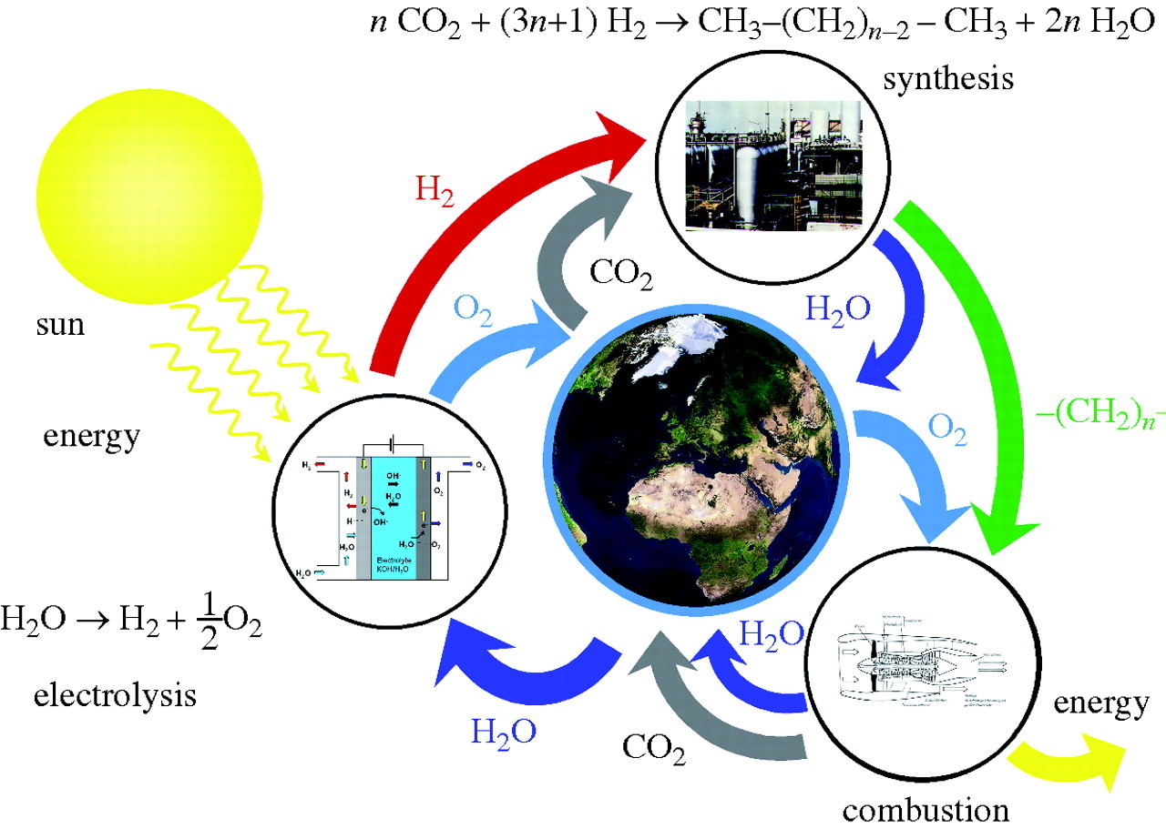
CONCLUDING REMARKS
  Zuttel et al., Phil. Trans. R. Soc. A, 2010, 368, 3329 - 3342
  CCU processes involving captured CO₂ and renewable H₂ are effective in the production of carbon neutral synthetic fuels and chemicals
  The use of catalytic materials allows the synthesis of selected products (fuels & chemicals)
  Catalysis for CO₂ activation is still at the early stages and there is still much work to be done
  Working in this area leads to a great satisfaction and allows you:
  to actively contribute to the resolution of the great problems of the new millennium
  to feel a protagonist in the "man made world" and not a simple spectator

Slide 27

Thank you for your kind attention!

Slide 28
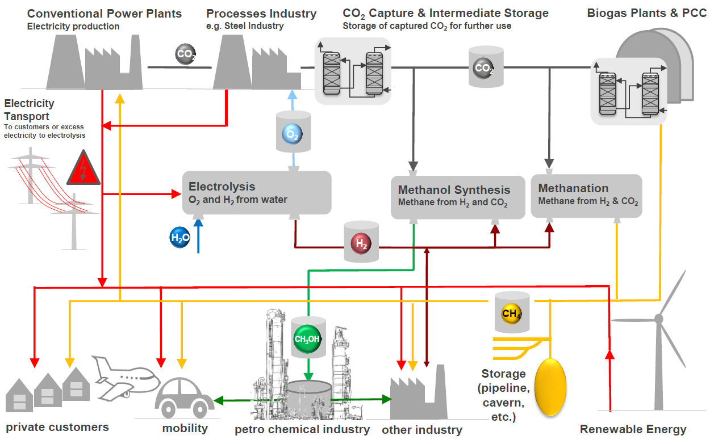

Integrated system for chemical CO2 utilization

